Slide 1


Department of Artificial Intelligence and Data Science
FOREVER Ecommerce Website
Arul Kumaran P
(221801004)
Harish Raghavendra R
(221801015)

Slide 2
Problem Statement
Small-scale businesses often face challenges in establishing an online presence due to high costs, technical complexities, and the limited availability of customizable, easy-to-use platforms.
Without an effective digital platform, small businesses struggle to reach a wider audience.
Many existing e-commerce solutions are tailored toward large retailers, making them cumbersome or inadequate for the unique needs of smaller enterprises.

Slide 3
Objectives
The primary objective of this project is to develop a lightweight, accessible, and visually appealing e-commerce web application to empower small-scale businesses in establishing an online presence.
By leveraging React.js and Tailwind CSS, the project focuses on creating a frontend-only solution that is responsive across various devices (e.g., mobile, tablet, and desktop), allowing for quick deployment, easy customization, and scalability.
The goal is to bridge the gap between small businesses and online consumers.

Slide 4
Abstract
Small businesses often encounter challenges in entering the digital marketplace due to high costs, complex platforms, and limited access to customizable, easy-to-use solutions. This application addresses these challenges by providing a lightweight, frontend-only solution that is accessible, visually appealing, and user-friendly. This system presents the development of a responsive e-commerce web application built with React.js and Tailwind CSS, designed to support small-scale businesses in establishing an effective online presence.

Slide 5
Introduction and Overview of the Project.
In today's digital age, having an online presence has become essential for businesses to remain competitive and reach a wider audience.
Small-scale businesses often struggle with the high costs and technical complexities associated with setting up an online store.
This system addresses these challenges by developing a responsive e-commerce web application using React.js and Tailwind CSS.
This system offers a component-based structure, allowing for modular, reusable code that enhances development efficiency and scalability.

Slide 6
LITERATURE REVIEW
S.No | Author Name | Paper Title | Description | Journal | Volume/ Year
1. | Smith, A., Johnson, R. | Exploring the Growth of User Expectations in eCommerce Platforms | Discusses the rapid growth of the eCommerce industry and how user expectations for online shopping experiences have evolved. | Journal of Digital Commerce and Consumer Behavior | 2022
2. | Li, Y., & Zhang, P. | Challenges and Solutions in Online Garment Retail | This study examines the challenges unique to garment eCommerce, such as accurate product representation, sizing consistency, and visual presentation. | International Journal of Retail and Distribution Management | 2021

Slide 7
LITERATURE REVIEW
S.No | Author Name | Paper Title | Description | Journal | Volume/ Year
3. | Kroeger, M., Patel, S., & Lee, T. | Advantages of React Framework in eCommerce Platform Development | The authors explore the use of React as a front-end framework in building dynamic, component-based eCommerce applications. | Journal of Web Development and Engineering | 2023
4. | Nguyen, H. | Optimizing Web Applications with Vite and Tailwind CSS Systems (EMS) | This research evaluates the role of Vite as a build tool and Tailwind CSS as a responsive design framework in modern web development. | Front-end Development Journal | 2023

Slide 8
Existing System
Several types of e-commerce systems exist today, each with its own unique features, benefits, and limitations.
Large-scale marketplaces are popular online shopping destinations where businesses can list their products
Social media and mobile commerce platforms have grown in popularity as mobile usage increases. These platforms allow businesses to sell directly to customers within a social media app.

Slide 9
Advantages and Disadvantages of Existing System
Limitations of Existing System:
High initial development costs.
Time-intensive to develop, deploy, and optimize.
Limited functionality and lack of advanced e-commerce features.
Monthly subscription fees, with additional costs for premium themes and plugins.
Features of Existing System:
Access to a large customer base and high traffic.
Secure payment processing and built-in customer support
Large community support and access to plugins/extensions
Secure Payment Processing
Centralized Database
User feedback

Slide 10
Proposed System
Affordability: A low-cost solution that does not require expensive subscriptions Comprehensive.
Modularity and Reusability: A component-based architecture that promotes reusability and easy maintenance, allowing business owners to adapt and expand.
Usability: A simple, intuitive user interface that enhances the shopping experience and encourages repeat visits.
Flexible grids: Using Tailwind’s grid system, content like product listings, images, and buttons will automatically adjust based on the screen size, ensuring no content is cut off or misaligned.
Responsive navigation: The navigation bar transforms into a mobile-friendly hamburger menu on smaller screens, ensuring easy access to all parts of the site, regardless of device size.

Slide 11
Advantages and Disadvantages of Proposed System
Features of Proposed System:
Responsive Design.
Modular Architecture.
Customizable Design.
Fast Load Times.
Limitations of Proposed System:
Dependence on External Integrations.
Limited Security Features.
Scalability Challenge for complex businesses

Slide 12
SYSTEM REQUIREMENTS
Software Requirements :
Frontend: HTML, CSS, JavaScript, React.js, Bootstrap,Tailwind CSS, Jest Framework.
Development tools: VS code, GIT, Github, Postman
Deployment and Hosting: Github pages and Netlify.
Security: JWT for authentication, BCrypt.js for password hashing, SSL certificates.
Payment Gateway: Stripe or PayPal for secure transactions.
Performance optimization tools: Google lighthouse, Percy.

Slide 13
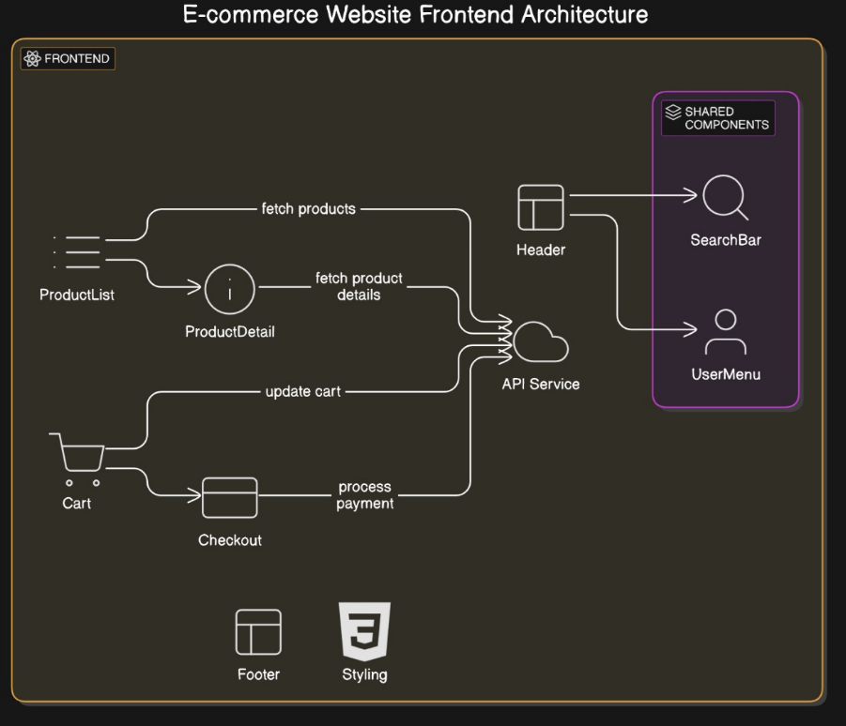
System Architecture

Slide 14
List of modules
1. Product Management Module.
2. Shopping Cart Module.
3. Order Management Module.
4. Contact and Support Module.
5. Payment Processing Module.

Slide 15
Product Management Module
Features:
Product Listing: Displays all available products on the home page or in specific categories.
Product Details: Shows detailed information about a selected product, including price, description, and availability.
Product Search and Filtering: Allows users to search and filter products based on categories, price, and other attributes.

Slide 16
Shopping Cart Module
Features:
Add to Cart: Users can add products to their cart directly from the product listing or details page.
Manage Cart: Users can update quantities, remove items, and view the total cost in their cart.
Save Cart State: Optional feature to save the cart state for logged-in users, allowing them to return and continue shopping later.

Slide 17
Order Management Module
Features:
Checkout: Collects payment and shipping information and confirms orders.
Order History: Allows users to view previous orders, including order details and status.
Order Status Tracking: Optional feature for users to track the status of their orders.

Slide 18
Payment Processing Module
Features:
Payment Gateway Integration: Enables secure payment processing.
Payment Status Updates: Confirms payment status and notifies the user.

Slide 19
Contact and Support Module
Features:
Contact Form: Allows users to submit inquiries or requests for support.
FAQ and Help Resources: Provides users with a knowledge base for common questions.

Slide 20
Software Testing: Forever Ecommerce Website
Software testing is essential for ensuring the reliability, functionality, and usability of FOREVER website. Here’s an overview of the different types of testing that could be employed to thoroughly test this shopping platform, along with some common testing practices and tools suitable for this project.
Usability testing focused on the website’s responsiveness and user interface.
Accessibility testing is a critical part of ensuring that a web application is usable by individuals with various disabilities, including visual, auditory, motor, and cognitive impairments.
Postman was used to test different HTTP methods (GET,POST, PUT, DELETE) by sending requests to the backend and examining the responses.

Slide 21
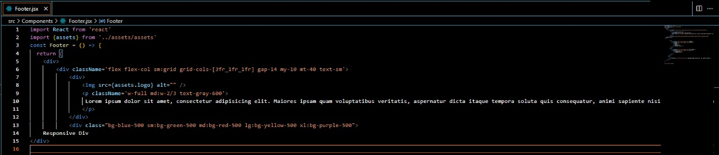
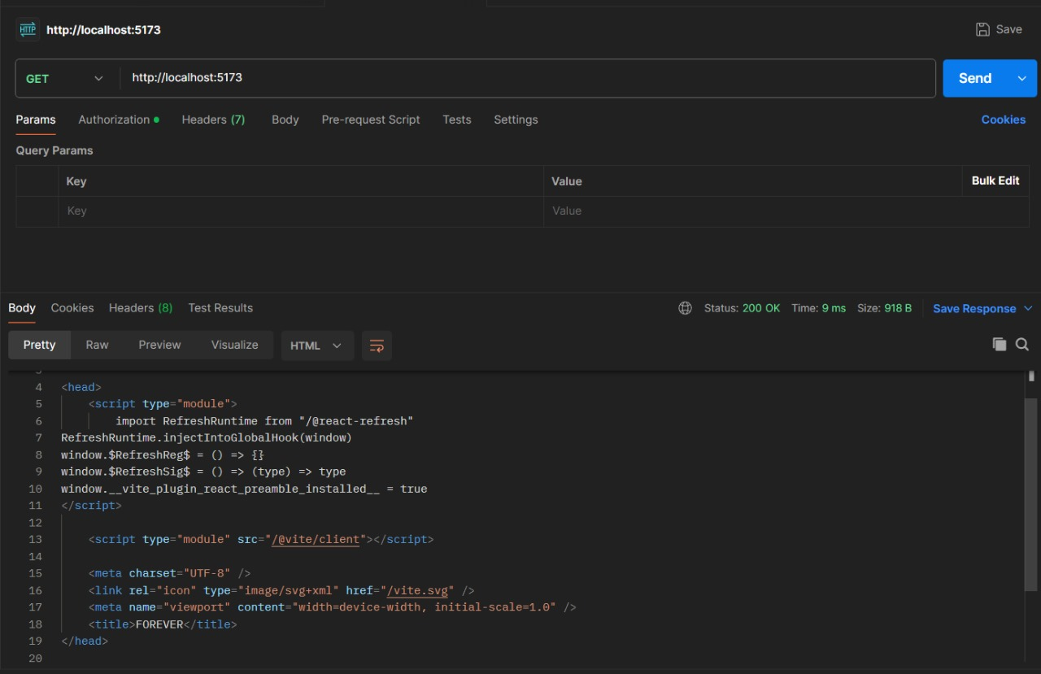
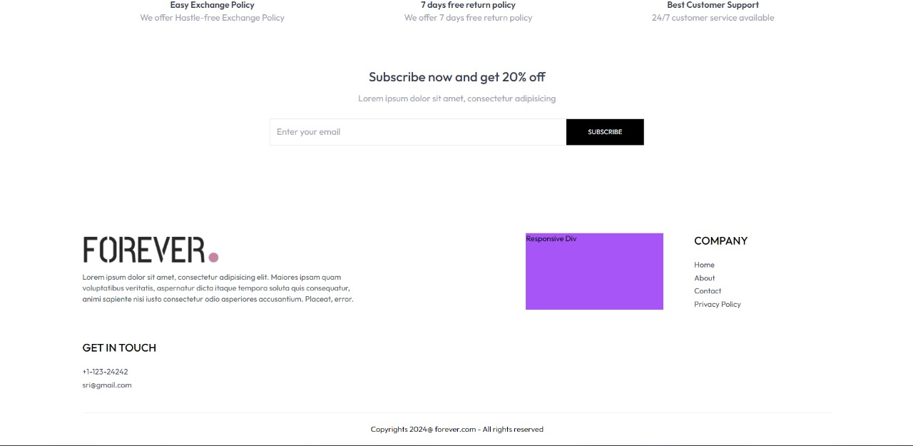
Software Testing: Forever Ecommerce Website (Output)

Slide 22
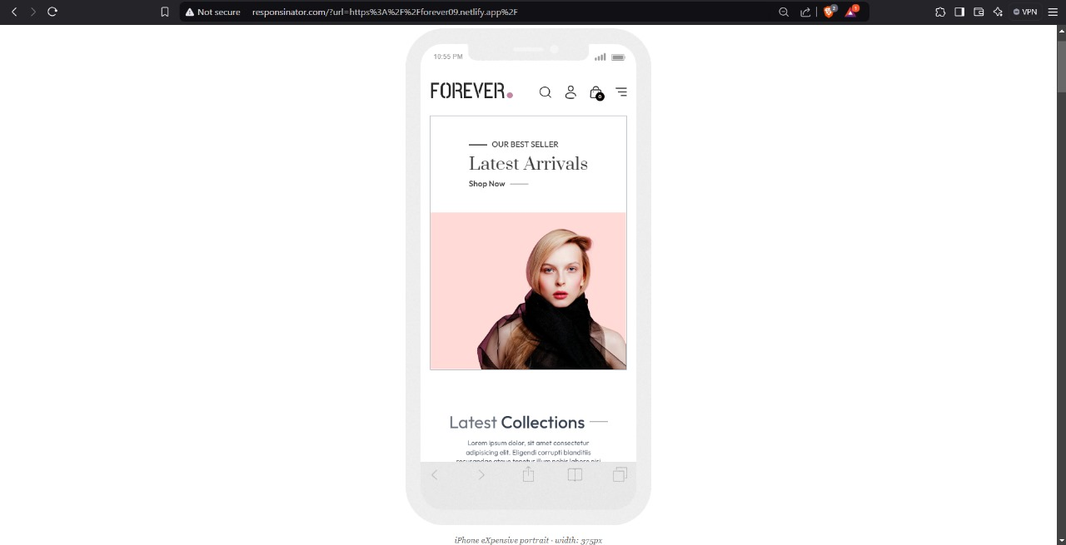
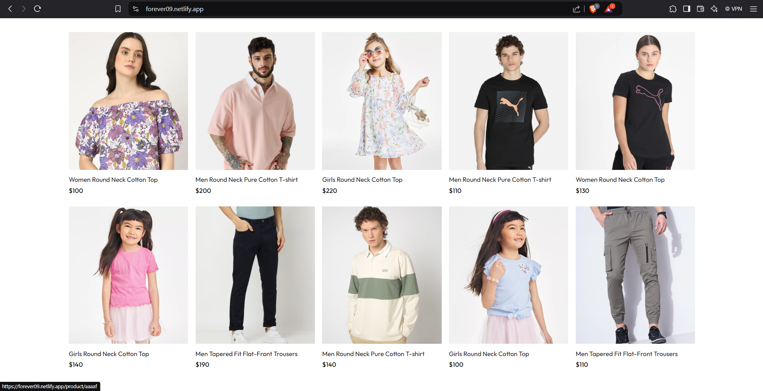
Visualization of Results

Slide 23
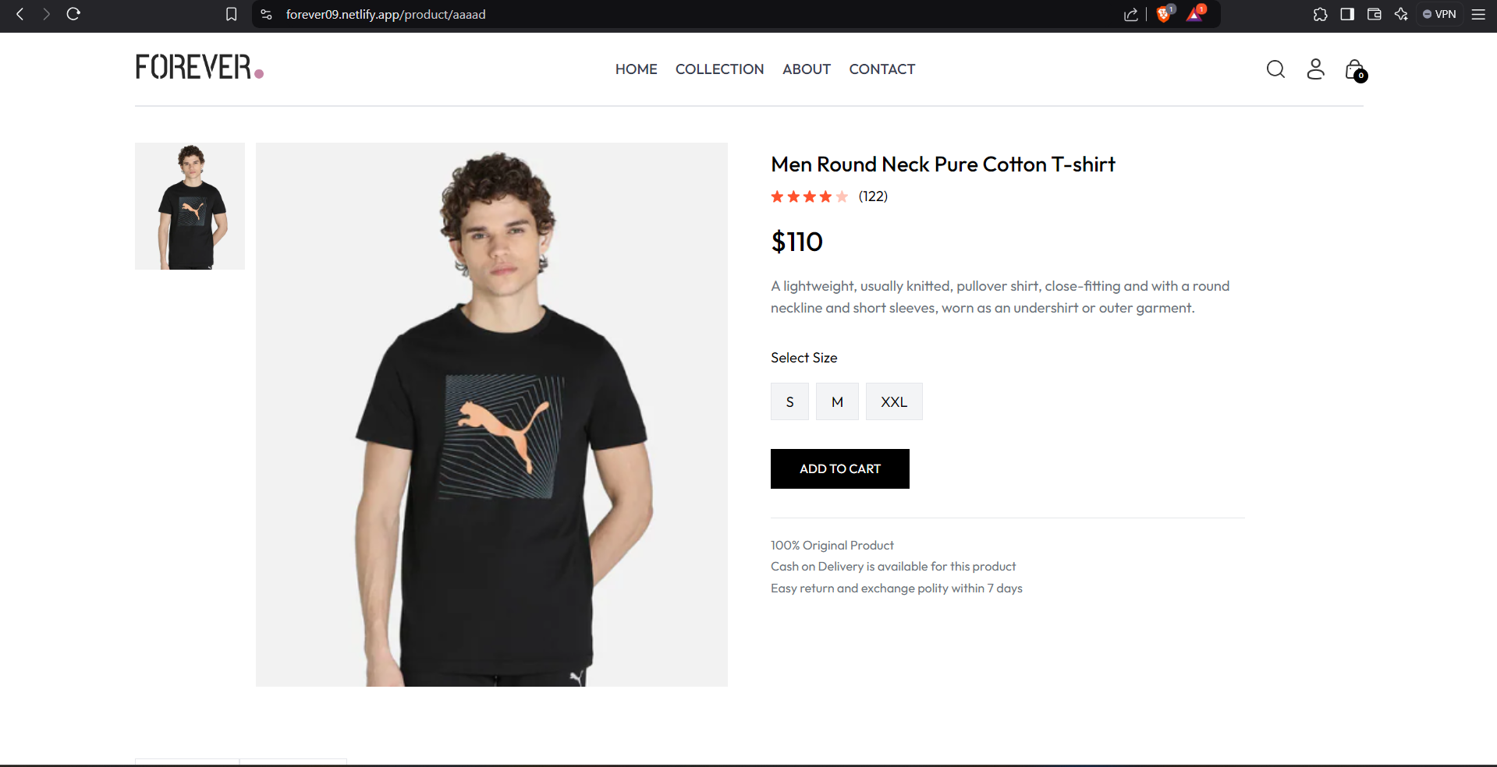
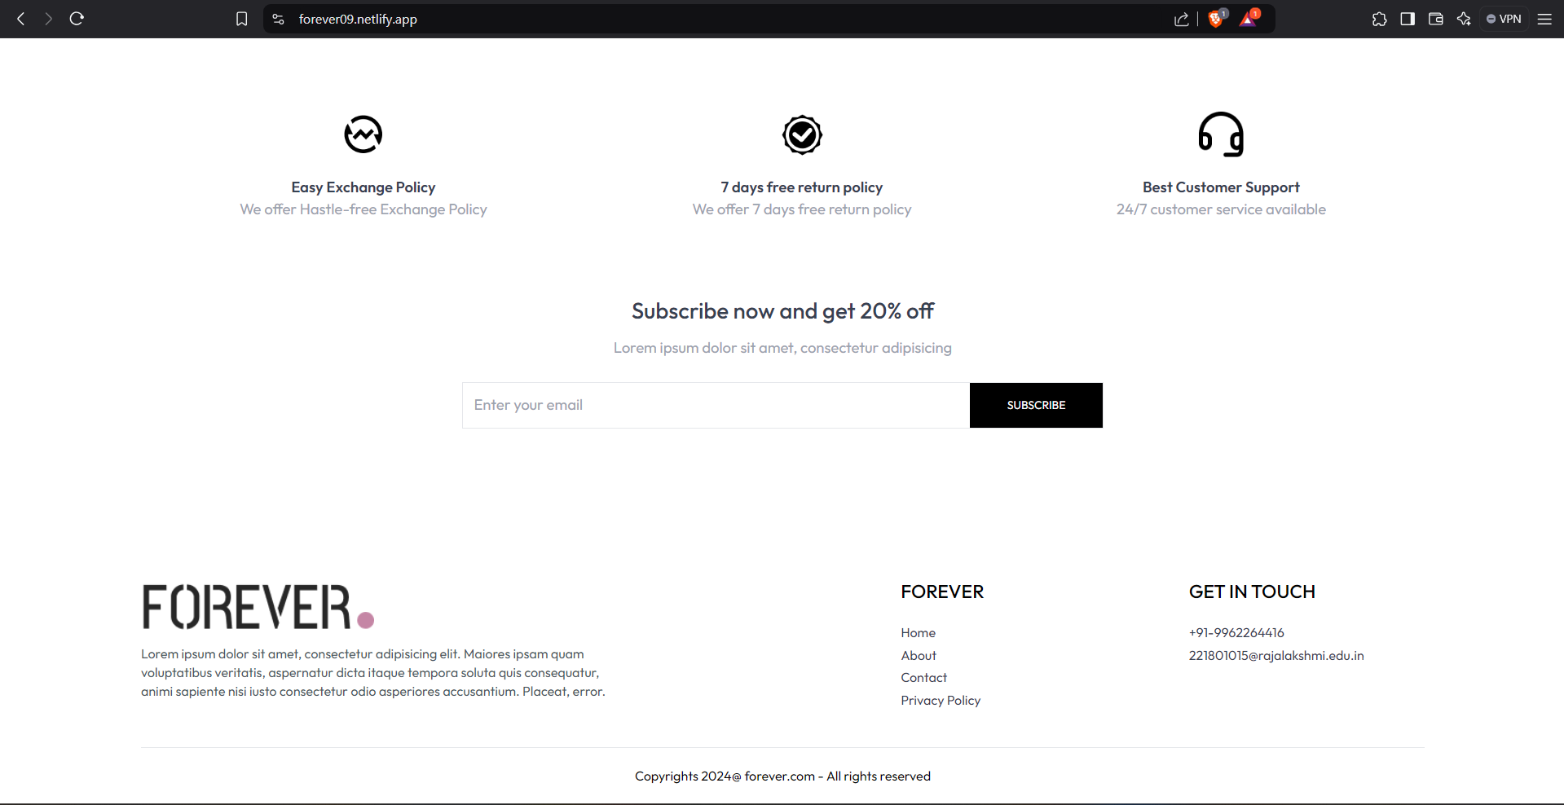
Visualization of Results

Slide 24
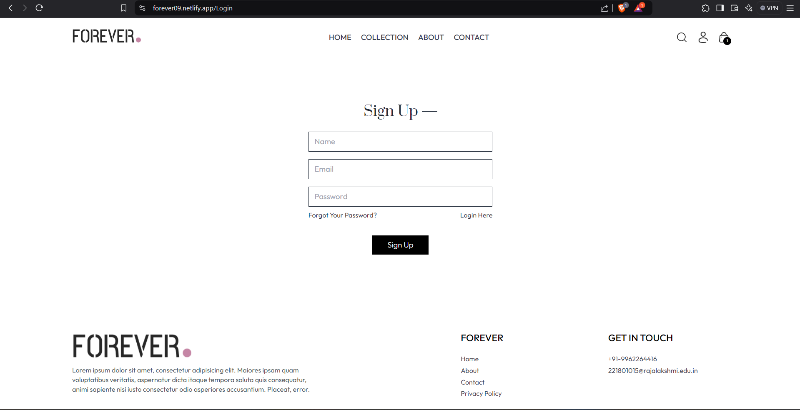
Visualization of Results

Slide 25
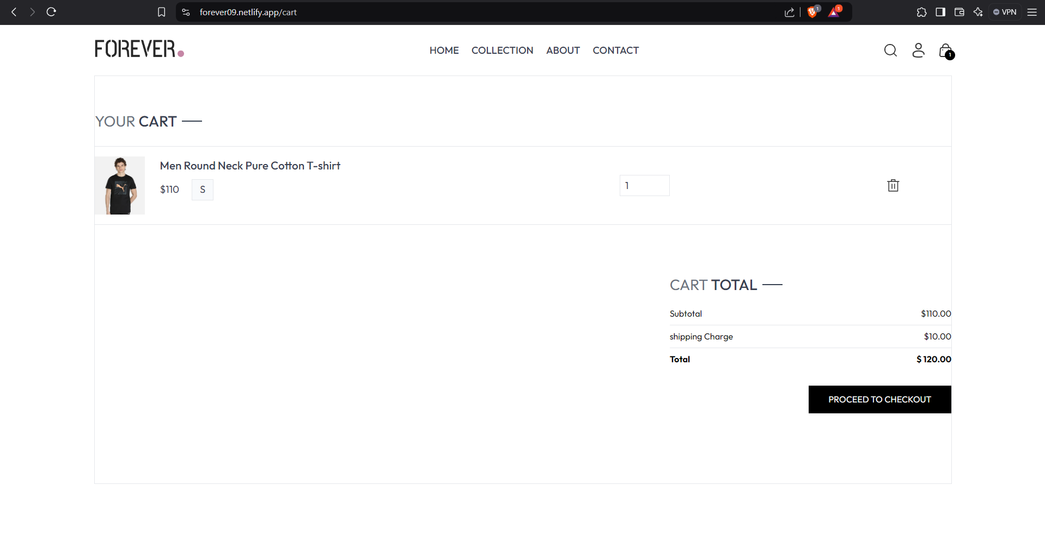
Visualization of Results

Slide 26
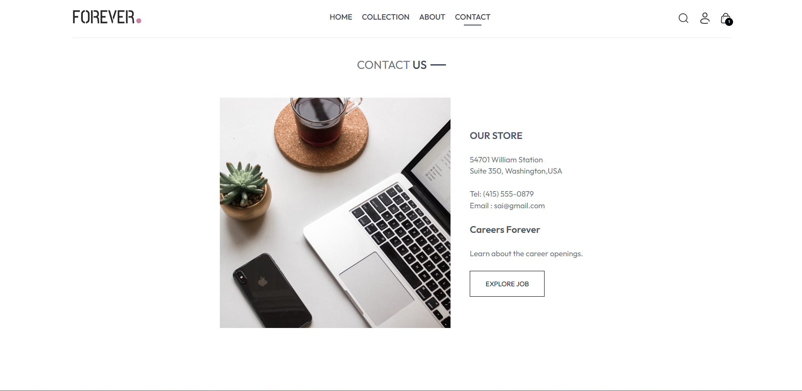
Visualization of Results

Slide 27
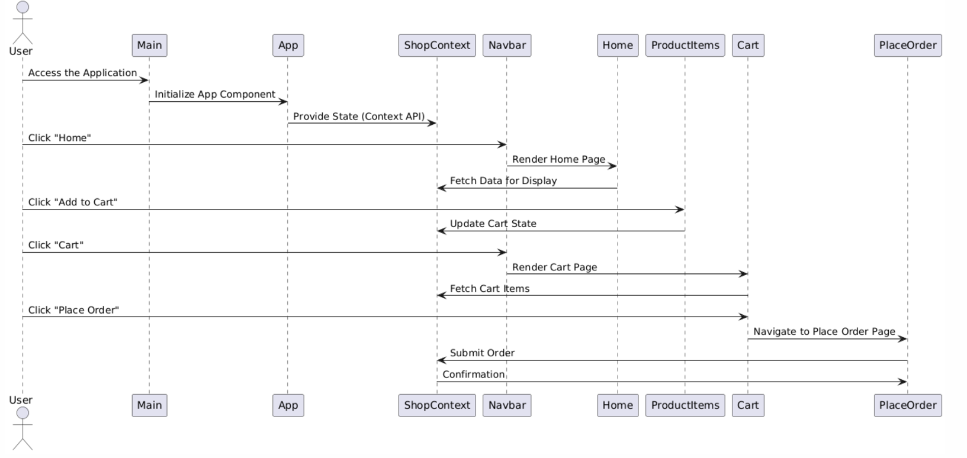
Sequence Diagram

Slide 28
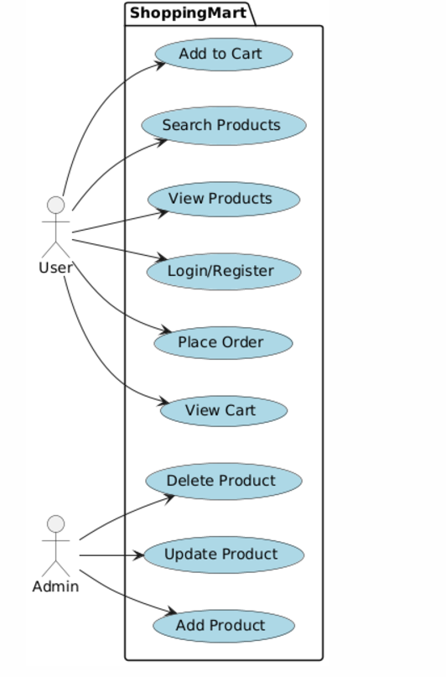
Use case diagram

Slide 29
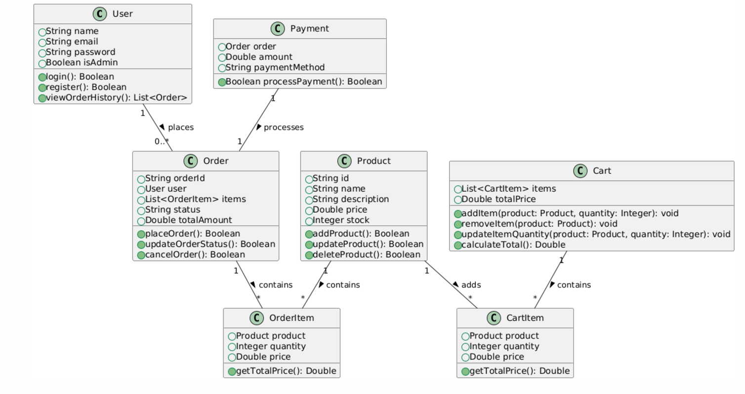
Class Diagram

Slide 30
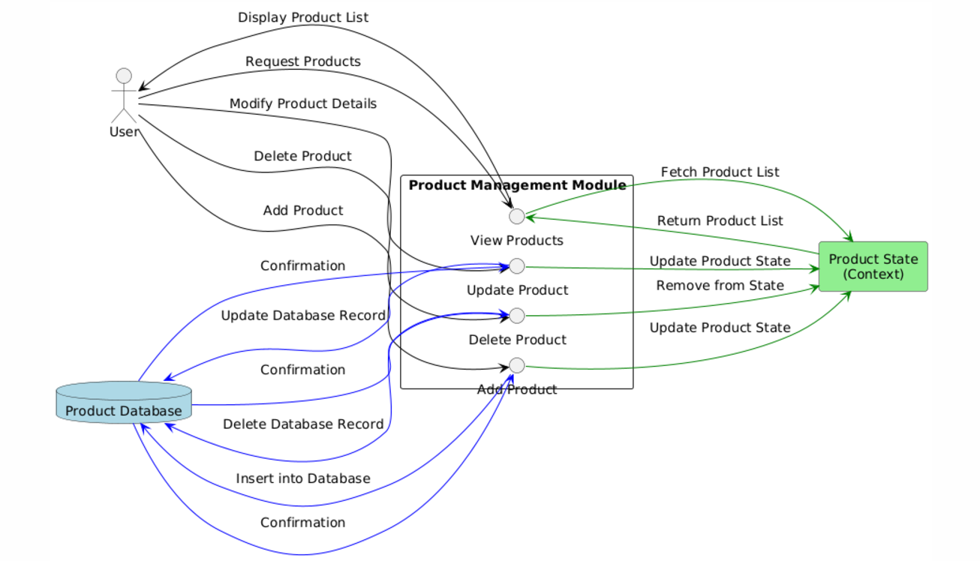
Product Management Module

Slide 31
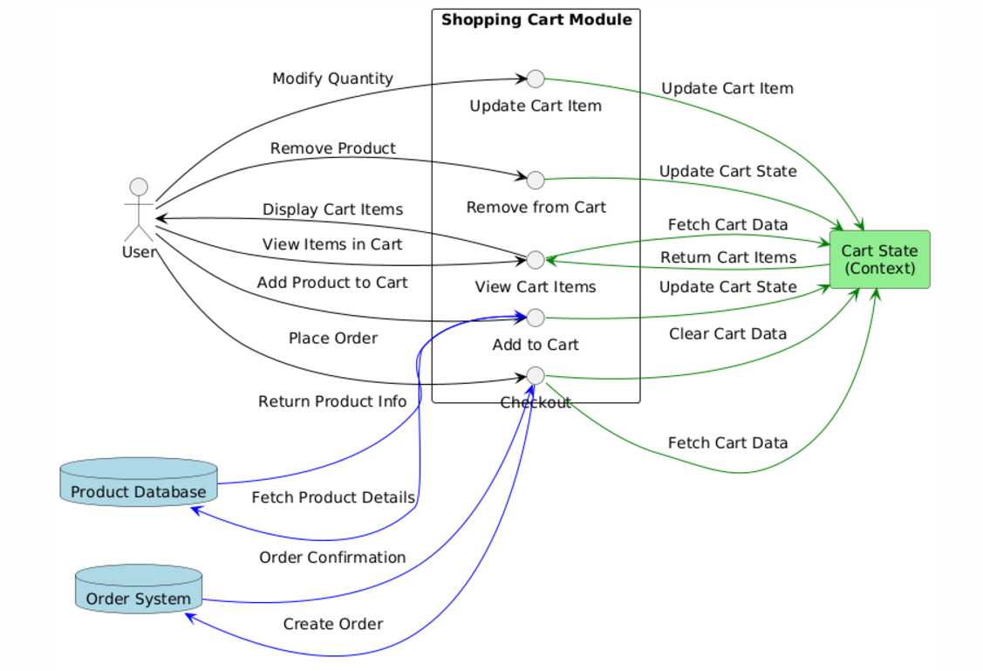
Shopping cart Module

Slide 32
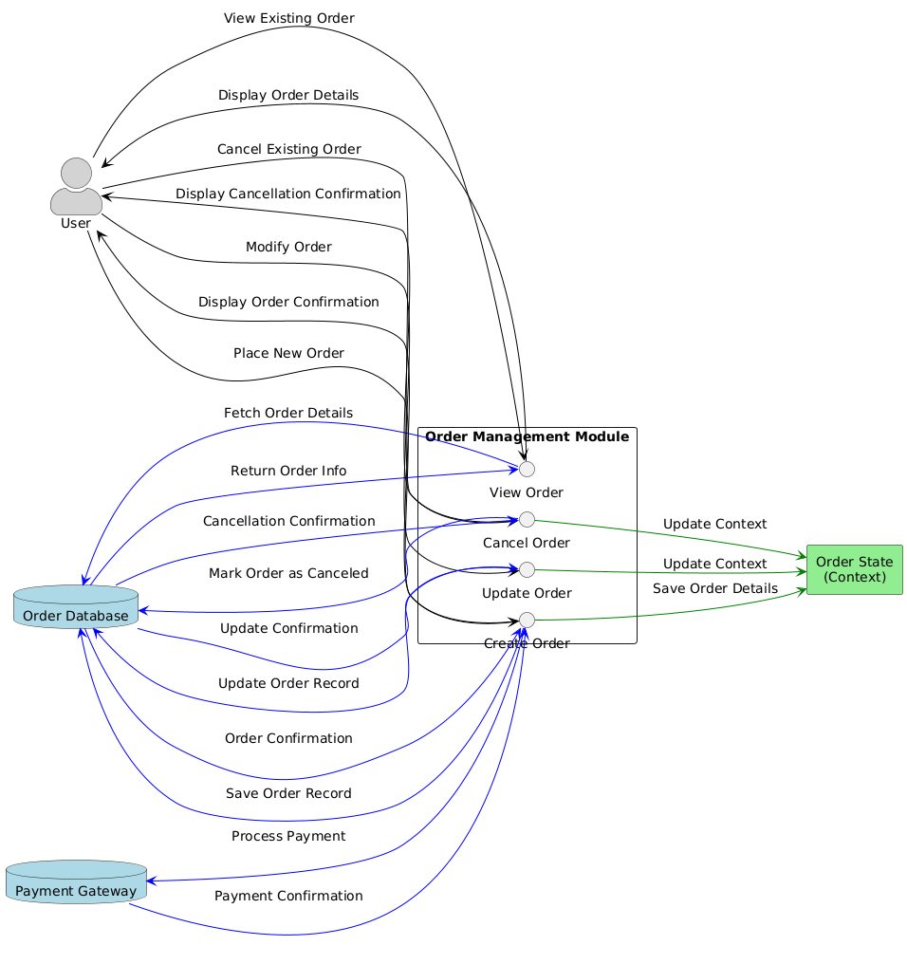
Order Management Module

Slide 33
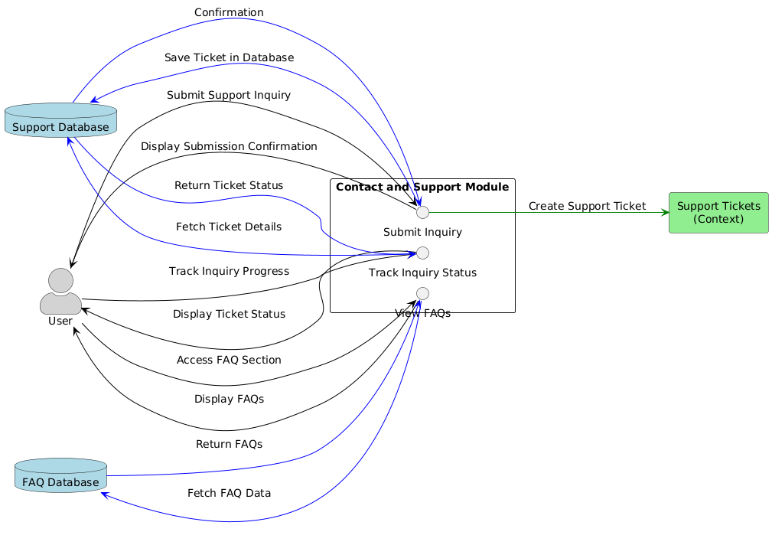
Contact and Support Module

Slide 34
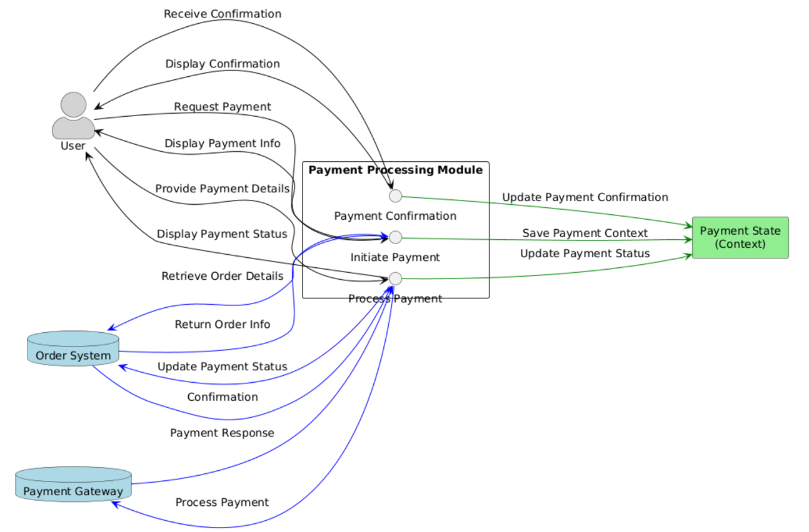
Payment Processing Module

Slide 35
Result and Discussion
The FOREVER Web Application project successfully created a functional, responsive, and accessible e-commerce platform using React for the frontend and Tailwind CSS for styling.
The development process focused on key features such as product browsing, a shopping cart, user authentication, and a contact form, all while ensuring a seamless user experience across devices.
The project demonstrates a solid foundation for future improvements, scalability, and the ability to deliver a secure, high-performance online shopping experience.

Slide 36
Conclusions
The Shopping Mart Web Application project successfully showcases the development of a fully functional e-commerce platform, utilizing modern technologies such as React for the frontend and CSS Tailwind for responsive and efficient styling.
This system demonstrates the ability to build and test a complex, interactive web application that adheres to modern standards for security, performance, and usability.

Slide 37
References.
[1] D. Duckett, HTML and CSS: Design and Build Websites, Wiley, 2011.
[2] M. Haverbeke, Eloquent JavaScript: A Modern Introduction to Programming, 3rd ed., No Starch Press, 2018.
[3] A. Banks and E. Porcello, Learning React: Functional Web Development with React and Redux, 2nd ed., O'Reilly Media, 2020.
[4] M. Lu and J. W. Palmer, "The Design and Testing of an E-Commerce Shopping Platform," Journal of Electronic Commerce Research, vol. 18, no. 3, pp. 1–10, 2020.
[5] R. J. Munz, R. Saherwala, and S. Munz, "A Guide to Testing in the React Ecosystem," Proceedings of the ACM Conference on Human-Computer Interaction, pp. 15–19, 2021
[6] Link - https://forever09.netlify.app/

Slide 38
Thank You

